Slide 1
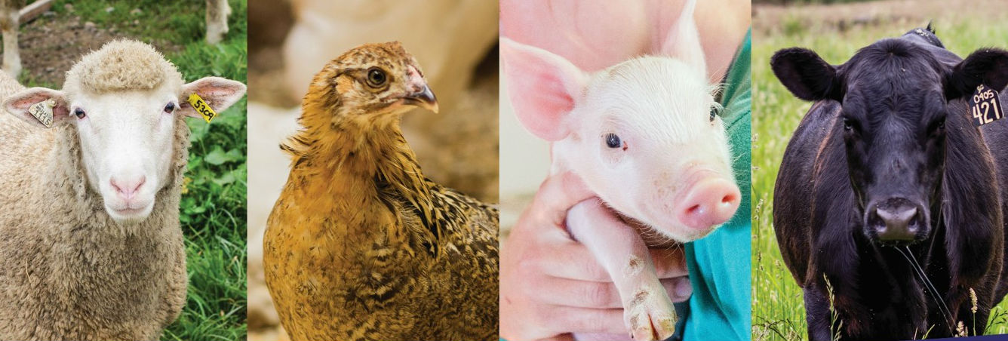
Feeding Your Exhibition Animals
  Changes are coming to medicated feeds for animals
Notes:
What is the issue?
To ensure a safe food supply, the Food and Drug Administration (FDA) oversees the use of animal medications. Some medications have been approved for use without a veterinarian's permission, while others require permission. Recently, the FDA changed how some antibiotic medications, which are important to human medicine, are used for animal feed. Starting January 2017 the Food and Drug Administration has made changes to the current regulations for medicated animal feed.

Slide 2
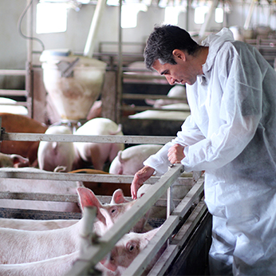
What Changes are Happening?
Medicated animal feed will be limited for all farmers, including youth.
In order to buy some medicated feeds, you will need to have a Veterinary Feed Directive (VFD) from a veterinarian.
This does not include injectable medications.
Notes:
What is a medicated feed and why is it used?
Medicated feed is feed with a specific drug added to it. Medicated feed is fed to animals to prevent illness or treat an animal when it is sick. Medicated feeds are just one of the good animal care and well-being practices farmers and animal owners use to keep their animals healthy.
What is a VFD drug and why did the FDA change their process?
A VFD drug is an antibiotic used for both human and animal medicine. It’s important these drugs are used correctly. The FDA’s job is to ensure these drugs are used properly which is why they are requiring a VFD order for some medicated feed beginning January 1, 2017.
How does a VFD order work?
A VFD order is similar to a prescription you would get from your human doctor, however a veterinarian will be giving you a VFD order for a medicated feed.

Slide 3
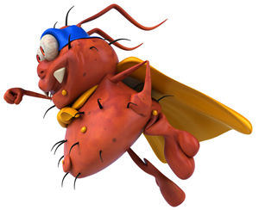
Why are Changes Happening?
To make sure the food we eat is safe!
Some of the medications we feed animals are also used to treat people.
Developing antimicrobial resistance in both people and animals - SUPER BUGS!
The Food and Drug Administration (FDA) wants to make sure the medications we use to cure disease and keep us healthy work!
Notes:
Why are changes happening?
Over the past several years, the FDA has taken important steps toward change in how medically important antibiotics can be legally used in feed or water for food-producing animals (livestock). These changes include; using medications in the feed for therapeutic uses ONLY (disease prevention or treatment) and to do so under the direction of a licensed veterinarian.
This is based on the fact that we are finding genes that are resistant to antibiotics. These genes can affect bacteria that are can be found in human and animals and can be harmful to both. In order to make sure that we have medications to treat both sick humans and animals it is important that we medications correctly when we feed our animals.

Slide 4
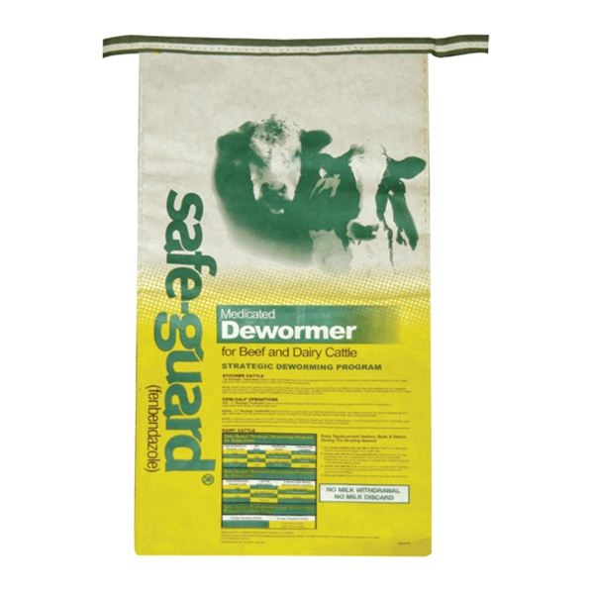
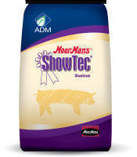
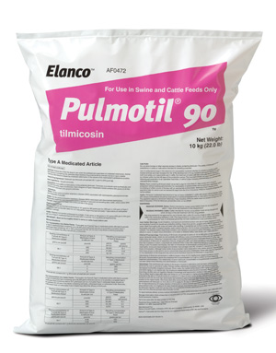
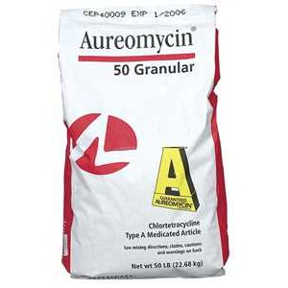
Will My Feed Need a VFD?
A list of all medication requiring a VFD is on the FDA website:
  http://www.fda.gov/AnimalVeterinary/DevelopmentApprovalProcess/ucm482107.htm.
Commonly used feed examples that now require a VFD include:
  Milk Replacers
  Chlortetracycline (CTC)
  Lincomycin (lincomix)
  Tylosin (Tylan)
  Oxytetracycline
NO
NO
YES
YES
YES
YES
CTC/DEN
Notes:
On this slide are some examples of feed products and whether they would be covered by the VFD:
Rumensin is an antibiotic, but not used in human medicine or called medically important, therefore no VFD needed
Safe guard is a fenbendazole (dewormer), but not used in human medicine and is not medically important, therefore no VFD needed
Aureomycin, contains chlortetracycline, a medically important antibiotic, therefore a VFD needed.
Pulmatiol, contains tilmocosin, a medically important antibiotic, therefore a VFD needed.
A medicated milk replacer containing chlortetracycline, a medically important antibiotic, therefore a VFD needed.
Most anthelmintics or dewormers such as Safe-guard are not affected, however hygromycin (Hygromix 8), used in Swine and Poultry is an affected drug and will require a VFD.
Are all antibiotics affected?
No, not all antibiotics will be considered VFD drugs. The use of injectable antibiotics will not be affected; and some drugs used in water will now require a prescription from a veterinarian.

Slide 5
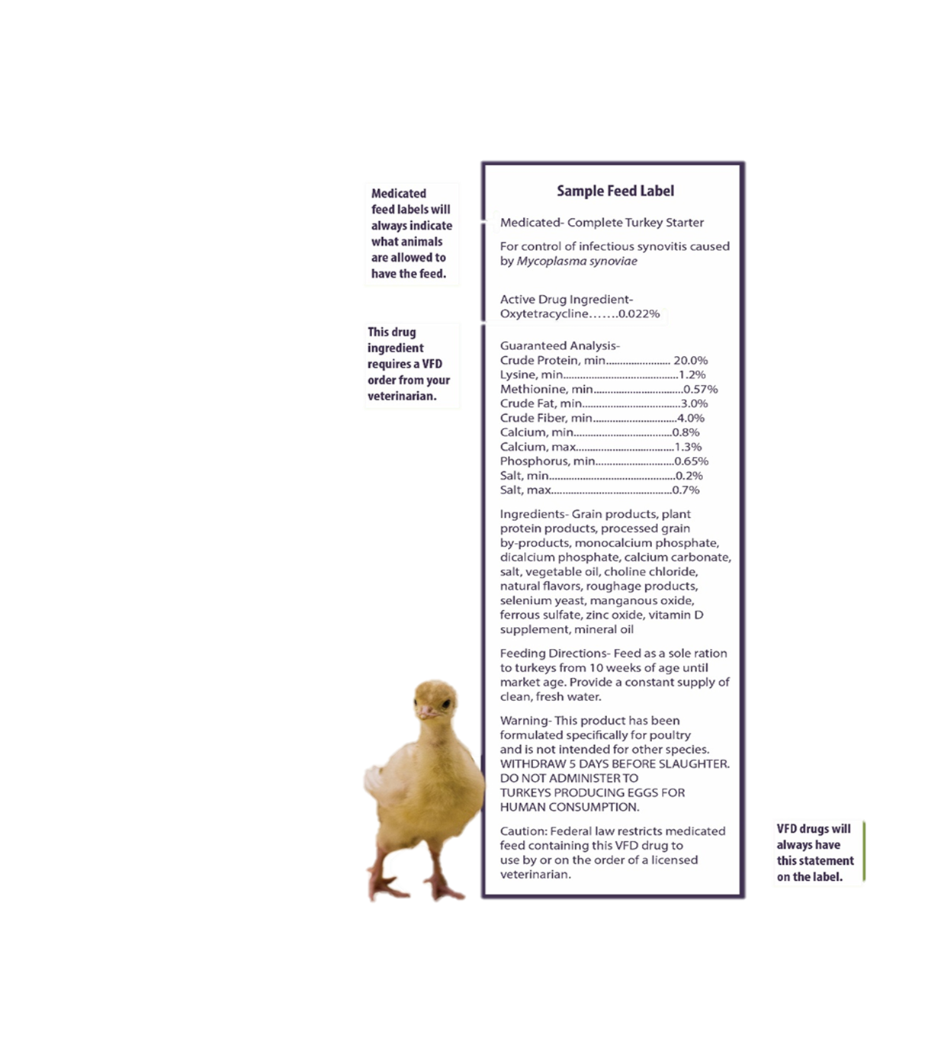
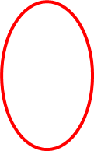
How do you Know if a Drug is a VFD Drug?
Read the feed label.
Feed mills or animal feed supply stores will not be able to sell feeds that need a VFD without proof from the veterinarian.
The feed label should say: Federal law restricts medicated feed containing this veterinary feed directive (VFD) drug to use by or on the order of a licensed veterinarian.
Notes:
How do you know if you need a VFD order?
As seen in the example, feed labels of VFD drugs have the following statement: “Caution: Federal law restricts medicated feed containing this VFD drug to use by or on the order of a licensed veterinarian.”
Will the feed mill sell me medicated feed without a VFD?
The feed mills are not allowed to sell medicated feed that requires a VFD, doing so is illegal.

Slide 6
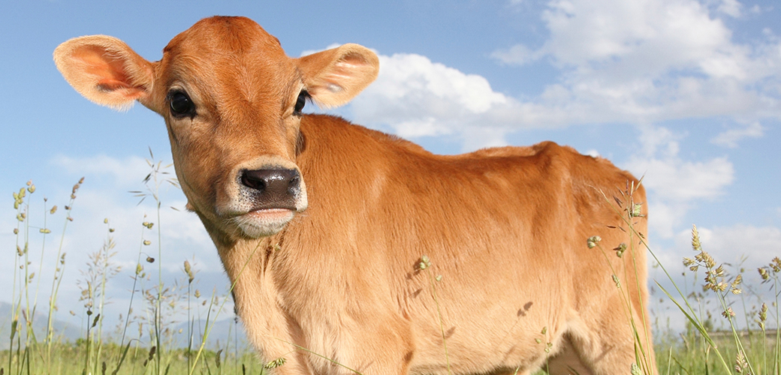
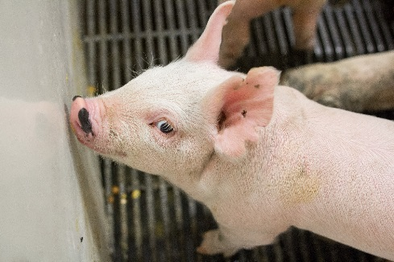
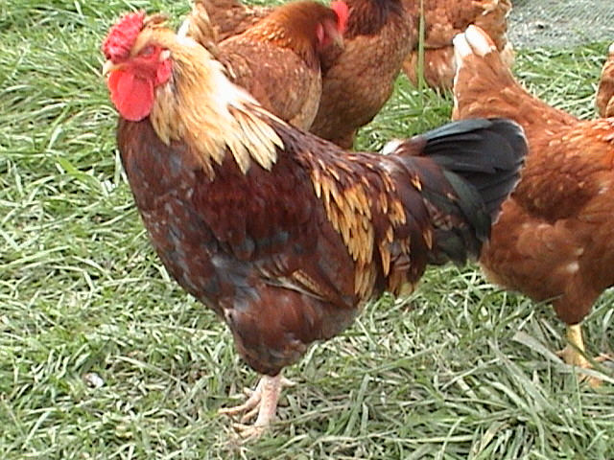
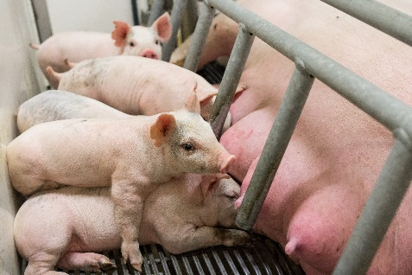
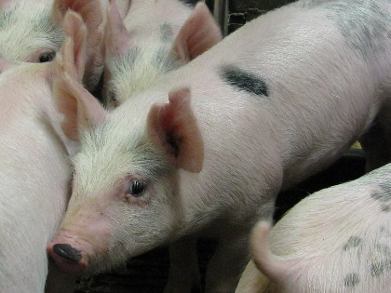
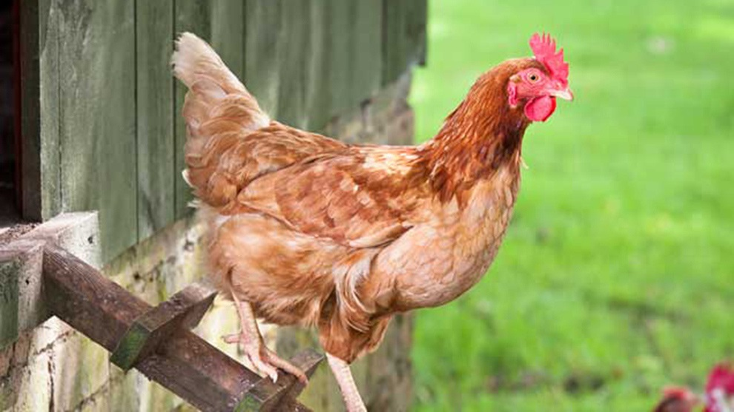
How Do I Get a VFD?
  To get a VFD, you must go through a licensed veterinarian.
  You must have a Veterinarian Client Patient Relationship (VCPR) with that veterinarian.
    They have seen your operation.
    They know how you take care of your animals.
    They do NOT have to make a farm visit every time you need to buy feed!
  The veterinarian will give you (or send directly to the feed mill) a VFD form so that you can buy medicated feed.
Notes:
How do you get a VFD order?
To get a VFD order, you must have an established veterinarian-client-patient relationship (VCPR) with a veterinarian. A VCPR is a working relationship between a veterinarian and a person who raises livestock (client). The veterinarian’s primary role is to help and advise the client in determining which medications are appropriate for their animals (the patients).
Your veterinarian should have a working knowledge of your farm and your animal care practices in order to give you a VFD>

Slide 7
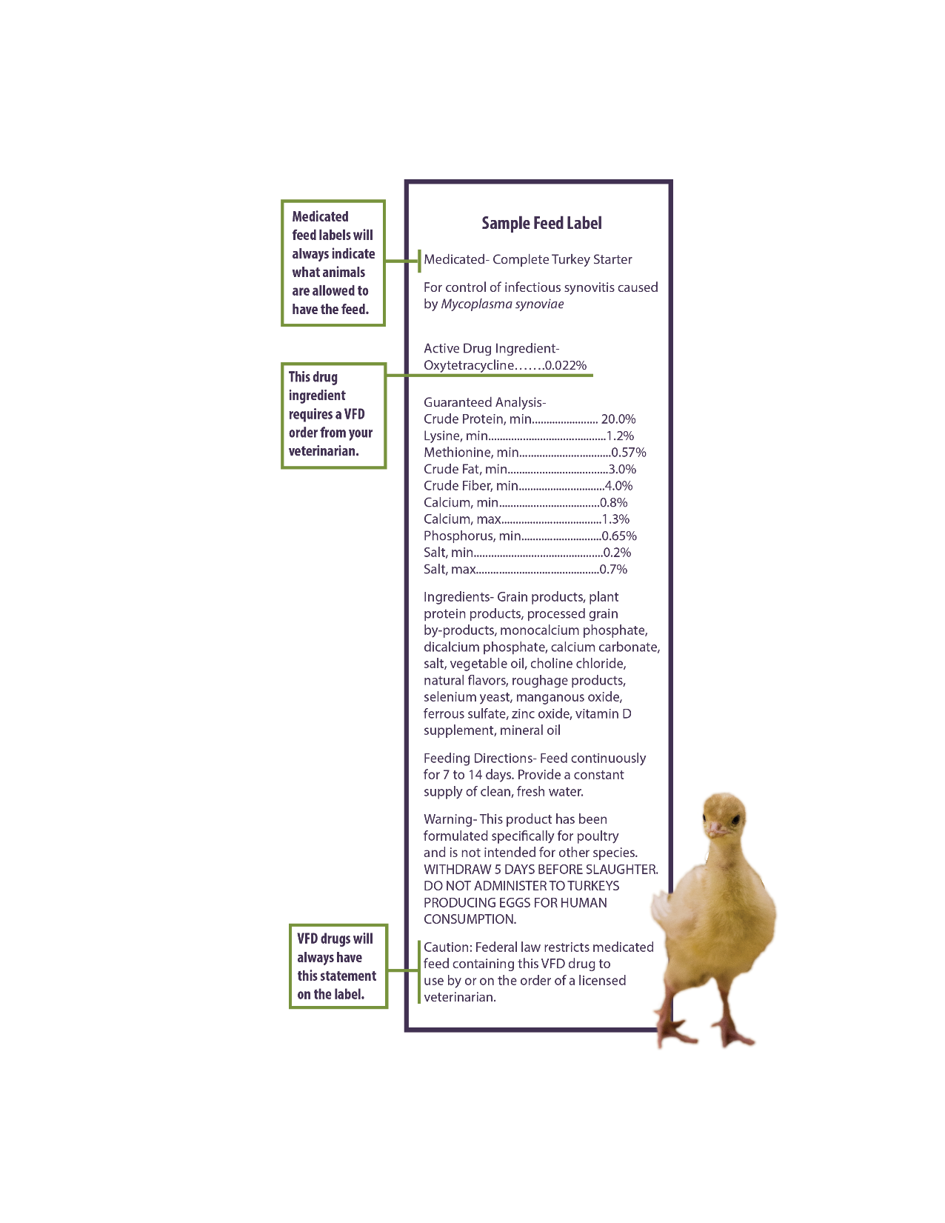
Why Can’t I use my Medicated Feed all the Time?
Healthy animals don’t need medications all the time.
Medications should only be used when your animal is sick.
This is part of the changes to the Veterinary Feed Directive – called duration of use.
Notes:
It is important to provide proper care for your animals. The correct environment, feed and fresh water, combined with daily operations are the keys to good health management. The focus of antibiotic use, either in feed, water or injectable should be as a last resort and a treatment option, not a routine practice that is relied on to assist with animal health.
What is duration of use?
In order to reduce the constant use of antibiotics the FDA has established duration of use guidelines for medications that specify how long a medication can be given to the animal. This information is required to be on the feed tag/label.

Slide 8
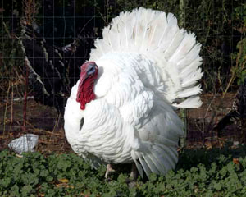
What Do I Need To Do Now?
Establish a VCPR immediately.
  Find a veterinarian that you can work with and ask questions.
When you need to use medications (in feed or injectable) for your animals, follow label or veterinarian
instructions completely.
Keep records of all medications used.
  Medicated feeds – 2 years
  Injectable – 1 year
Talk to your local feed mill or supplier about changes.
Notes:
How do I find a veterinarian?
MDARD and Global Link maintain lists of licensed veterinarians in the state.
Where can I buy feed with my VFD order?
You can buy VFD feeds at any mill, retailer or other establishment listed as a distributor or manufacturer with the FDA. If you are purchasing feed that requires a VFD order, you will need to present the VFD order before purchase.
How do feed stores check for VFD orders?
Previously, VFD feeds were purchased without documentation at your feed store or mill. However, starting January 1, 2017, you must first present a VFD order, written by a veterinarian, to purchase VFD feeds.
What records will I need to keep?
Records will need to be kept by the livestock owner, veterinarian and feed sales company for two years. The original VFD order will be kept by the veterinarian. The livestock owner and feed mill must also keep copies on file.

Slide 9
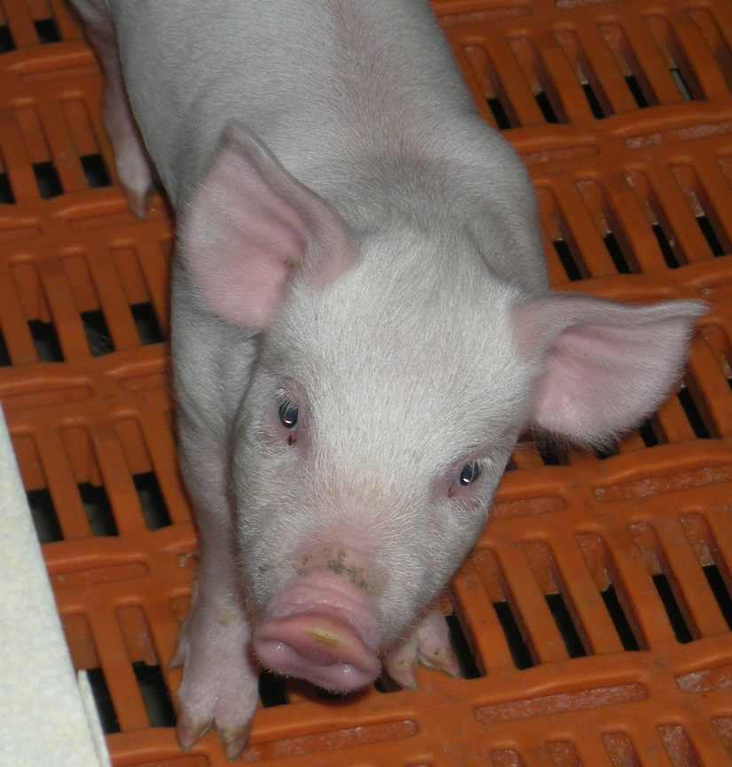
What is My Job?
Buy healthy animals!
Practice good animal care first! Medications second!
  Good environment, good feed and water, good care.
Listen to your veterinarian’s advice
  What to medicate with.
  How long to use medications.
Follow the VFD rules.
Notes:
Good animal care is the first role of the youth exhibitor, providing the proper environment and diet for the animals is key for a successful project. Know what resources are available (Leader, Ag teacher, producer, MSUE) for guidance will also help the youth troubleshoot any issues that come up.
The regulations starting January 2017 are federal laws and will need to be followed by all producers (youth included) sourcing medicated feed.

Slide 10
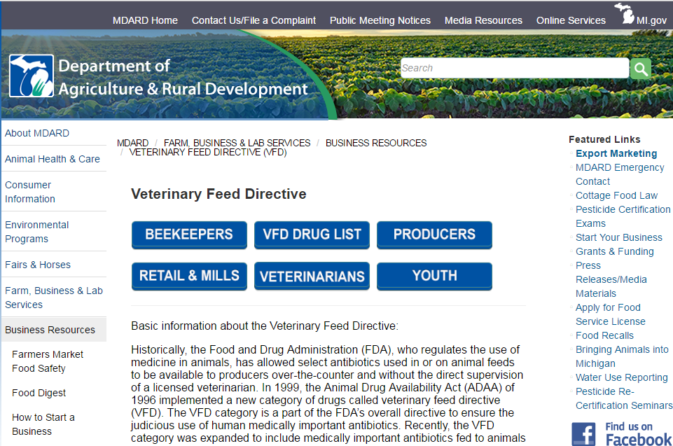
Resources: Ask Questions, We Can Help
Michigan Department of Agriculture and Rural Development
  www.michigan.gov/vfd
MSU Extension
  Dr. Madonna Benjamin
    gemus@cvm.msu.edu
  Beth Ferry
    franzeli@msu.edu
Your Veterinarian
Notes:
Other information can be found on the MSUE website.

