Slide 1

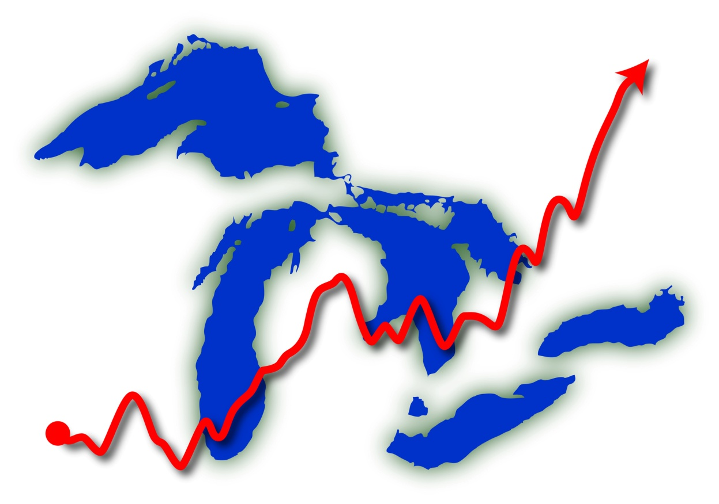



CLIMATE CHANGE IN THE GREAT LAKES REGION
Daniel Brown, Research Associate, GLISA

Slide 2
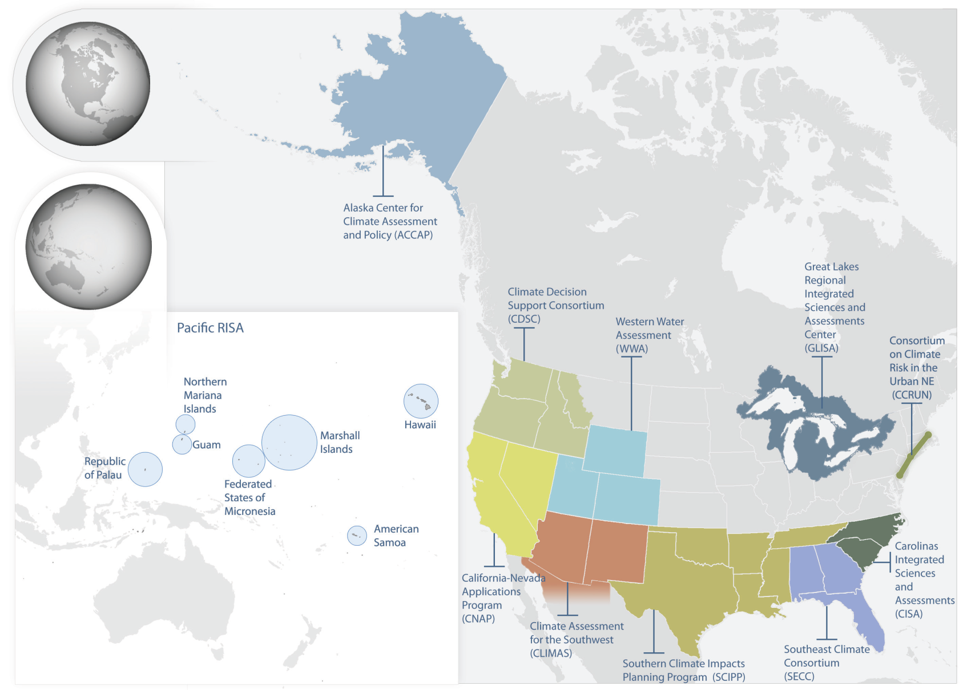

Regional Integrated Sciences and Assessments
(RISA)

Slide 3



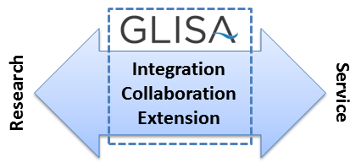

What does GLISA do?
glisa.msu.edu
GLISA is an information
network hub for integrated
climate science
Connects practitioners
and scientists

Slide 4
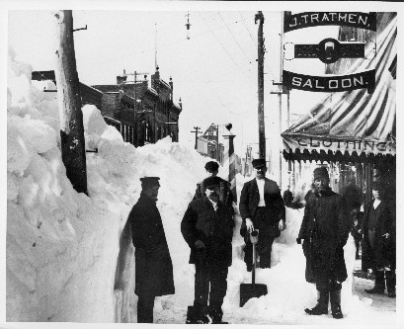
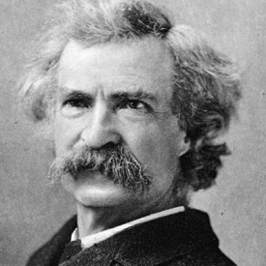
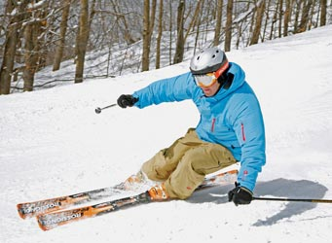
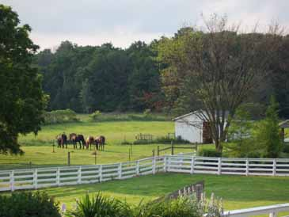
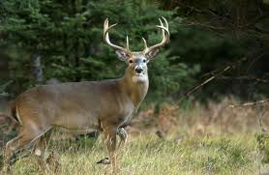
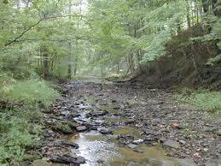
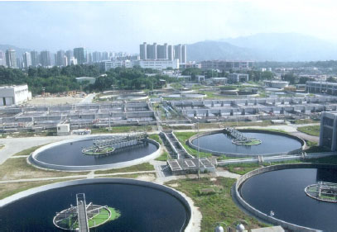
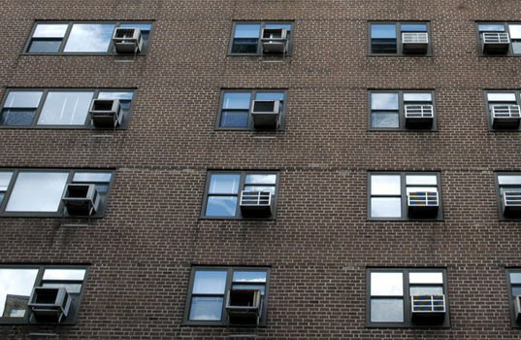
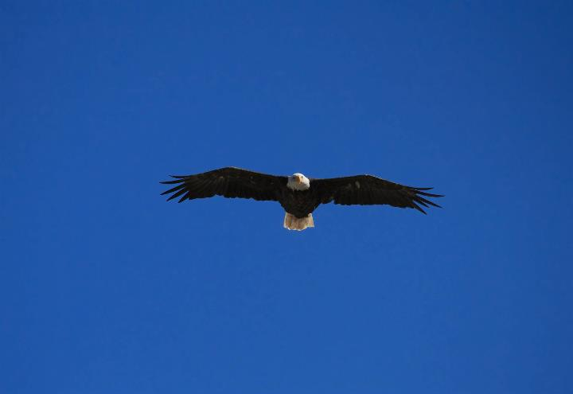
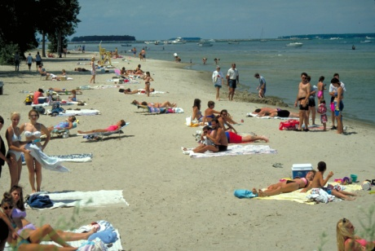
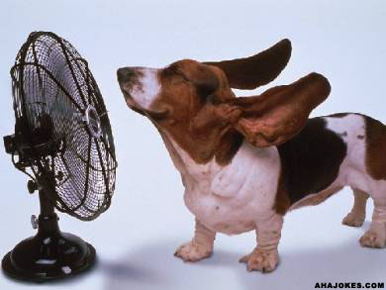
Why Care About Climate Change?
"Everybody talks about the weather,
but nobody does anything about it.”
—Mark Twain, 1897
Climate regulates life on the planet.
Climate determines how we live.
Photo credits: michigan.org, MSU, Daniel Brown, Wikipedia.org, ahajokes.com

Slide 5
Outline of the Presentation
Observed Changes
How has the global and regional climate changed?
Projected Future Changes
What are the projected global and regional changes?
Potential Impacts
What are the expected regional impacts?

Slide 6
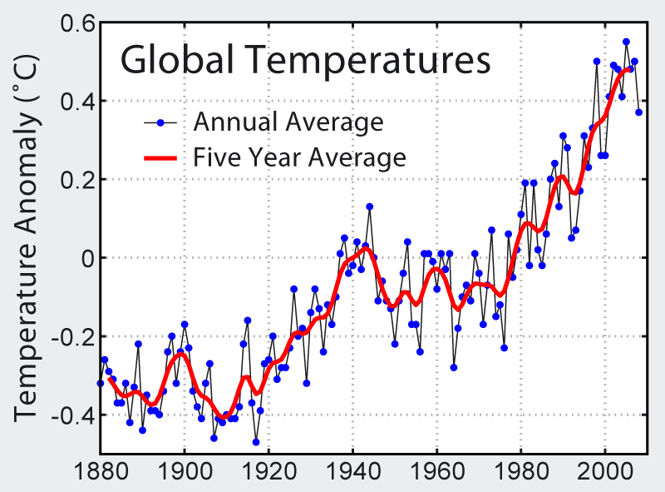
Observed Global Temperature
~1.5°F
NASA, Hansen et al., 2006
Notes:
This image shows the instrumental record of global average temperatures as compiled by the NASA's Goddard Institute for Space Studies. The data set used follows the methodology outlined by Hansen et al. (2006). Following the common practice of the Intergovernmental Panel on Climate Change, the zero on this figure is the mean temperature from 1961-1990.
The uncertainty in the analysis of global temperature is discussed in Foland et al. (2001) and Brohan et al. (2006). They estimate that global averages since ~1950 can be expected to be within ~0.05 °C of reported values with 95% confidence. In the recent period, these uncertainties are driven primarily by considering the potential impact of regions where no temperature record is available. For averages prior to ~1890, the uncertainty reaches ~0.15 °C driven primarily by limited sampling and the effects of changes in sea surface measurement techniques. Uncertainties between 1980 and 1890 are intermediate between these values.
Incorporating such uncertainties, Foland et al. (2001) estimated the global temperature change from 1901 to 2000 as 0.57 ± 0.17 °C, which contributed to the 0.6 ± 0.2 °C estimate reported by the Intergovernmental Panel on Climate Change (IPCC 2001a, [1]). Both estimates are 95% confidence intervals.

Slide 7
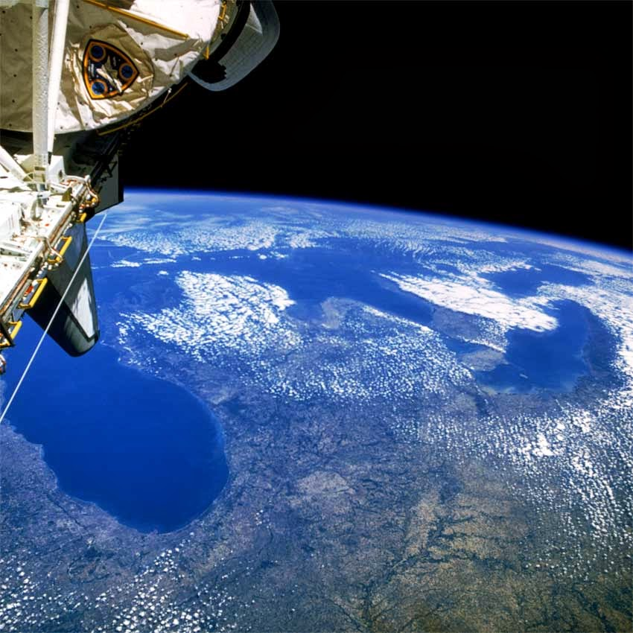
The World is Warming…
…but what about the Great Lakes Region?

Slide 8
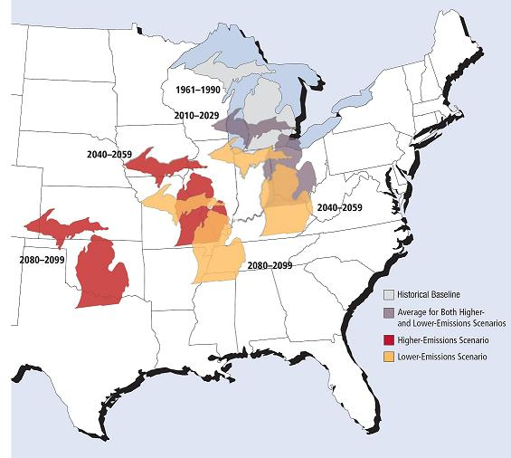
A Migrating Climate
The climate future generations experience will be fundamentally different than the climate today.
By the end of this century, Michigan summers will feel more like current summers in Arkansas.
Courtesy UCS 2009, original work by Hayhoe et al.

Slide 9
What has Changed?
Temperature
Averages
Extremes
Precipitation
Averages
Extremes
Seasonality
Seasonality
Scientists often discuss changes in terms of averages, but our environments are managed in terms of timing and extremes.

Slide 10
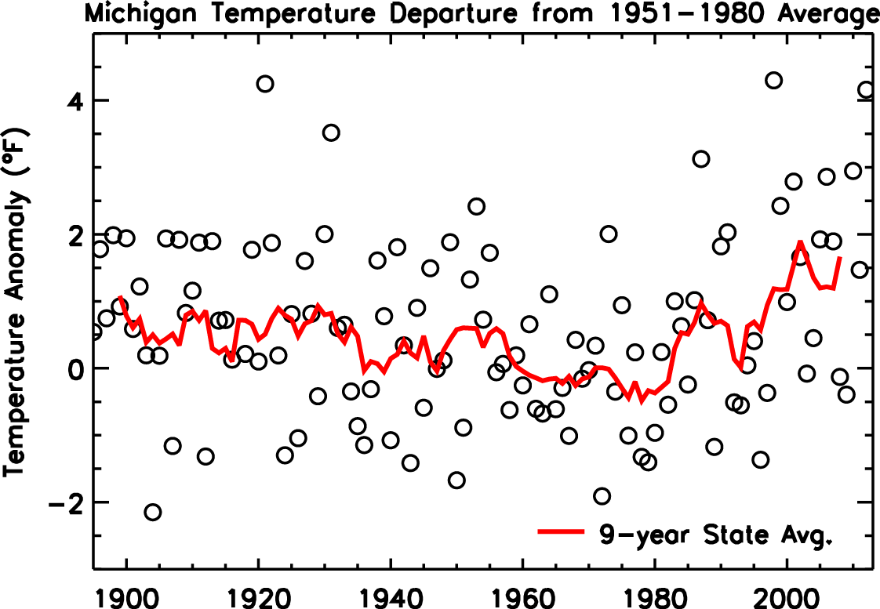
Observed Michigan Temperature
Changes in Average Temperature (°F) from 1951-1980 to 1981-2010
Annual | 0.9
Winter | 1.9
Spring | 1.1
Summer | 0.5
Fall | -0.1

Slide 11
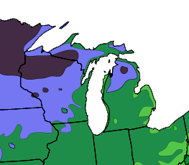
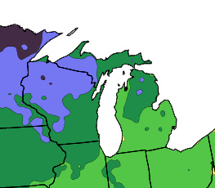
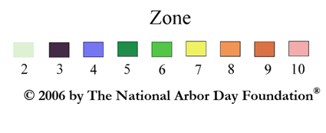
Migrating Plant Hardiness Zones
1990
2006
-40 to
-30 ºF
-40 to -30 ºF
-30 to -20 ºF
-30 to -20 ºF
-20 to -10 ºF
-20 to -10 ºF
-5 to -10 ºF
Average Extreme Minimum Temperatures

Slide 12
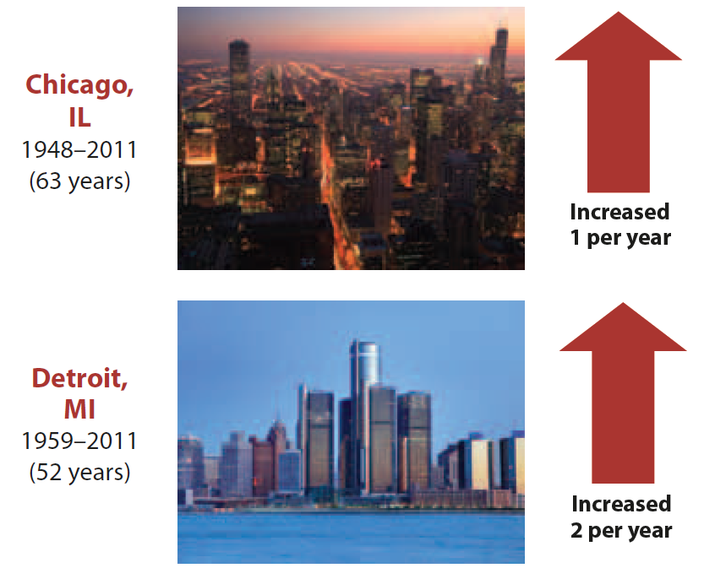
More Heat Waves and Hot Days
Observed Change in Number of
Harmful Heat Waves
The number of heat waves that pose risks to human health have increased in most major Midwestern cities.
Increasing overnight, minimum temperatures have increased at a faster rate, limiting relief during hot periods.
UCS Heat in the Heartland, 2012

Slide 13
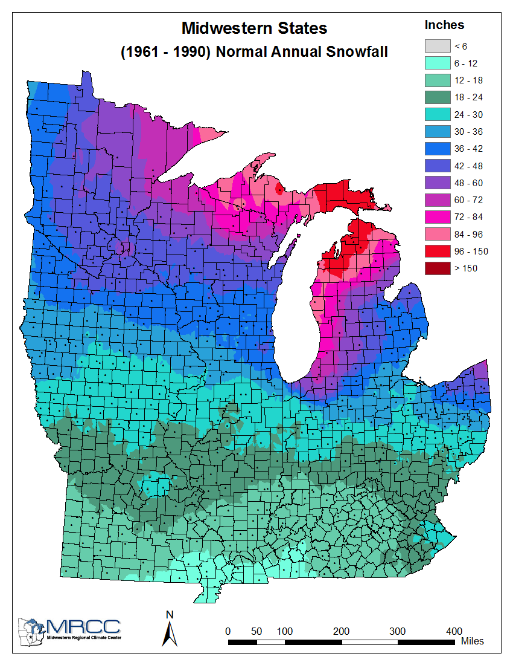
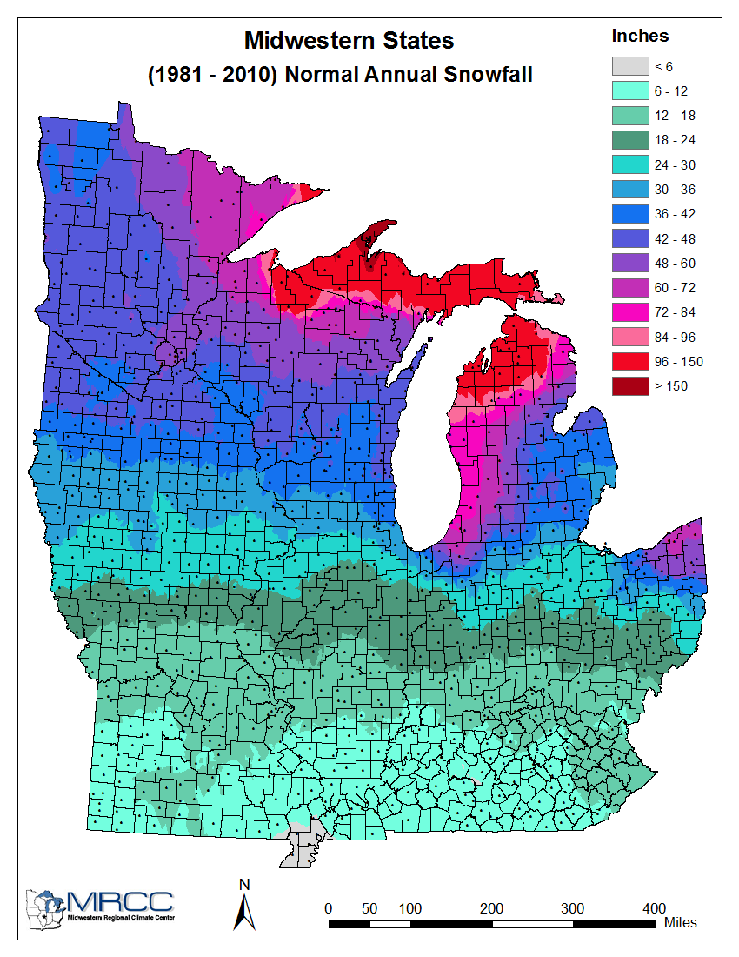
Observed Snowfall
1961-1990 Average
1981-2010 Average
More here
Less here
Snowfall has generally increased across the Northern Midwest, remained stable in the central latitudes, and has decreased in the southern areas.

Slide 14
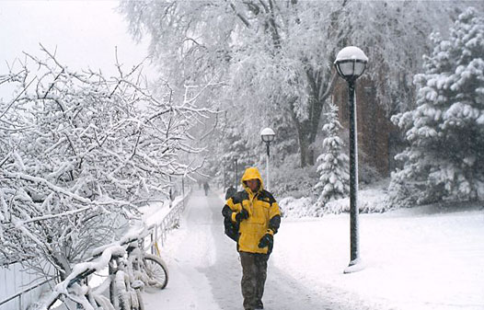
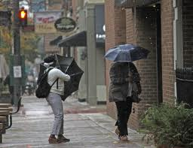
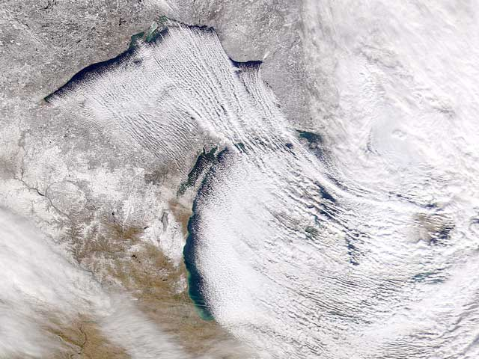
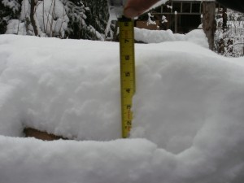
Changing Winter Precipitation
Shorter winters have lead to more precipitation falling as rain instead of snow.
Warmer surface temperatures have reduced snow
accumulation.
More lake effect
precipitation events
have increased snowfall in some areas.
Photo credits: Umich.edu, NASA, weather.com

Slide 15
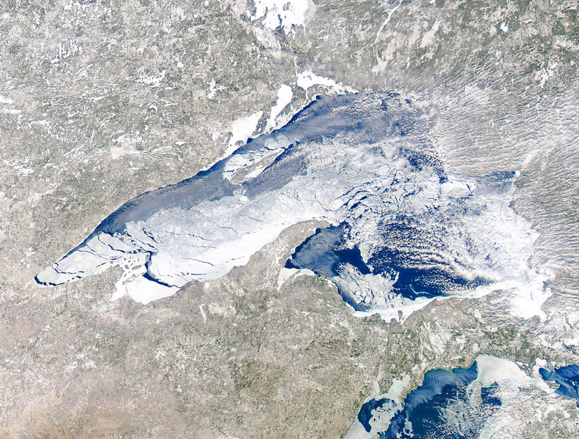
The Great Lakes are Warming
Average Great Lakes ice coverage
declined 71% percent from 1973 to 2010
AMS, 2011
Lake Superior is warming
twice as fast as nearby air.
Winter ice cover is decreasing.
Lake Superior could have little to no open-lake ice cover during a typical winter within the next 30 years.
NASA
Austin and Colman, 2007
Notes:
Based on historical records, the current rate of winter ice decline, Lake Superior could have periods of little to no open-lake ice during a typical winter within three decades. (Austin and Colman, 2007)

Slide 16
Grand Traverse Bay Ice Cover

Slide 17
Longer Midwestern Growing Season
Growing season longer by
~1-2 weeks
Earlier last winter frost in spring
Date of first winter frost is often unchanged
Based on data from the National Climatic Data Center for the cooperative observer network and updated from Kunkel et al. (2004)
Notes:
Based on data from the National Climatic Data Center for the cooperative observer network and updated from Kunkel et al. (2004)

Slide 18
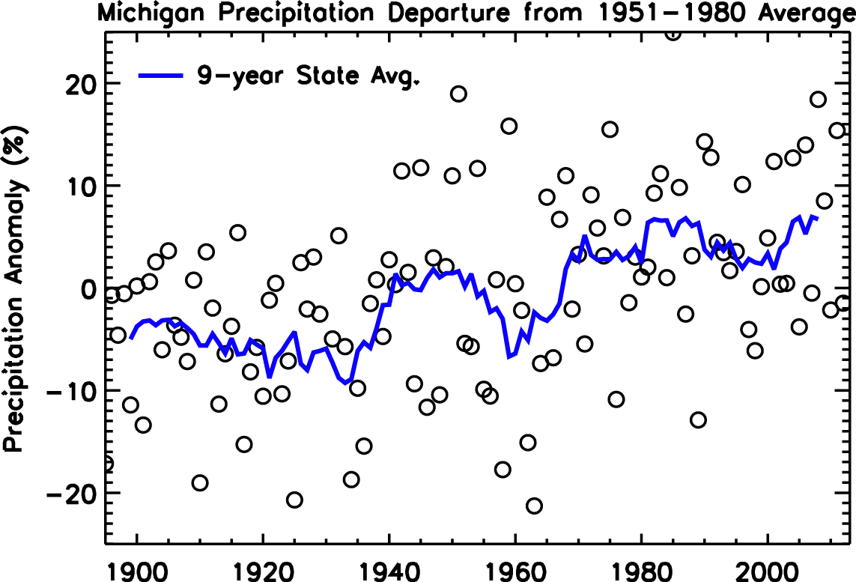
Observed Michigan Precipitation
Changes in Total Precipitation (%) from 1951-1980 to 1981-2010
Annual | 5.0
Winter | 5.6
Spring | 1.3
Summer | -1.0
Fall | 15.8

Slide 19
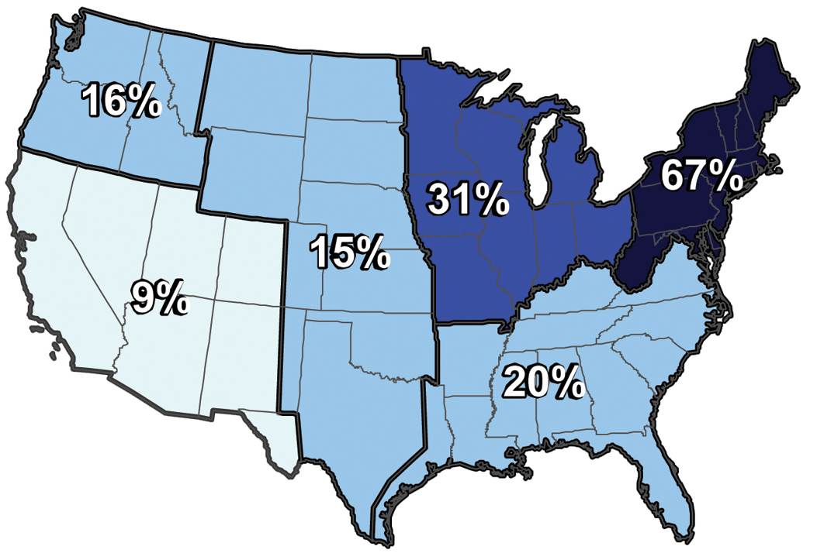
Observed Extreme Precipitation
The Intensity of the heaviest 1% of precipitation events increased by 31% in the Midwest and by 67% in the Northeast from 1958 to 2007.

Slide 20
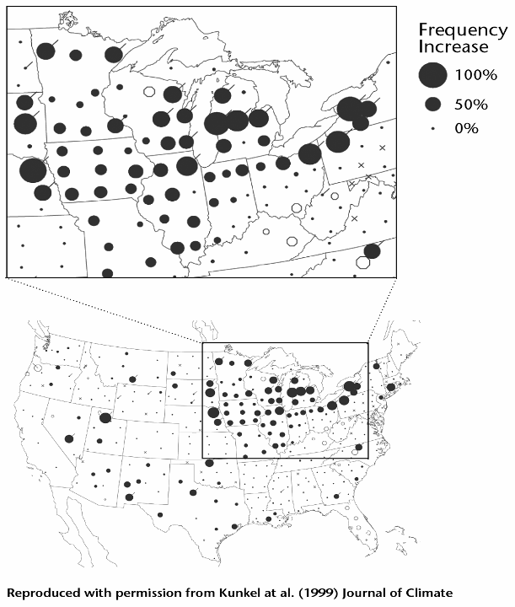
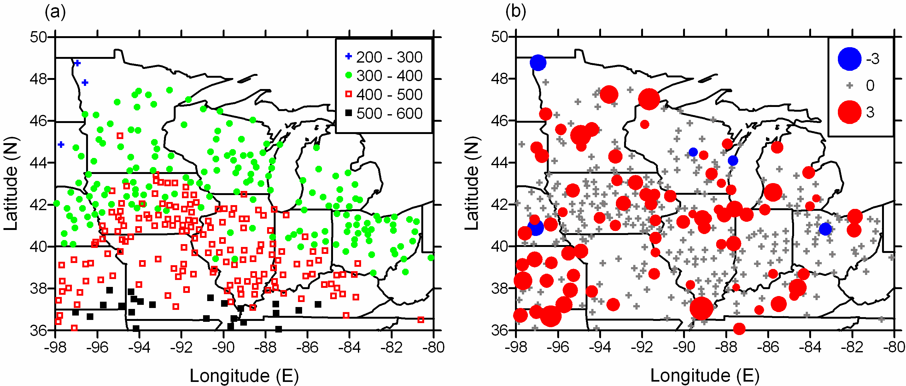
Observed Extreme Precipitation
The 10 wettest days in a year are delivering more precipitation.
The frequency of the heaviest 7-day precipitation events has increased.
(Pryor et al., 2009)
Notes:
Left: United States climate division trends in frequency of precipitation events of 7-day duration exceeding a 1-yr recurrence interval
for 1931–96. Shaded circles indicate upward trends while open circles indicate downward trends. The magnitude of the trend is given in
terms of the percent increase or decrease over the period 1931–96, relative to the 1931–96 mean. As indicated by the key, the magnitude
of the trend is linearly proportional to the radius of the circle. A tail attached to the upper right indicates positive trends with local significance
at the 5% level, two-tailed test; a tail attached to the upper left indicates locally significant negative trends. An ‘‘3’’ indicates a climate
division with no stations with complete records for the period 1931–96.
Right: Percent per decade change in precipitation delivered by the 10 wettest days in a year from 1901-2000.

Slide 21
Lake Levels
Lake Michigan lake levels have fallen since the 1980s.
It is still unclear how much of the recent trend in lake levels may be attributed to climate change.
GLERL Great Lakes Water Level Dashboard

Slide 22
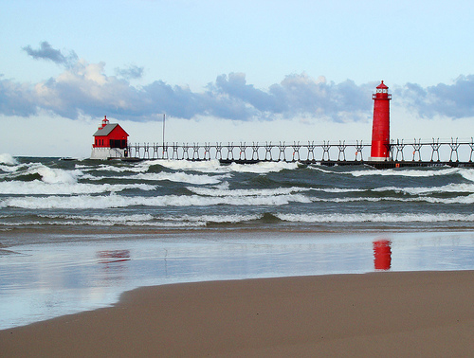
Summary of Existing Trends
Temperature is rising
Especially in winter
Winters are shorter
Spring comes earlier
Less ice cover
Precipitation is changing
    More rain
    More snow becoming rain
    More extreme events
Lake levels are declining

Slide 23
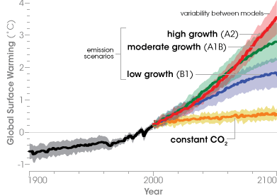
Future Global Temperature
6.5°F
3.2°F
3.2°F
NASA, based on IPCC

Slide 24
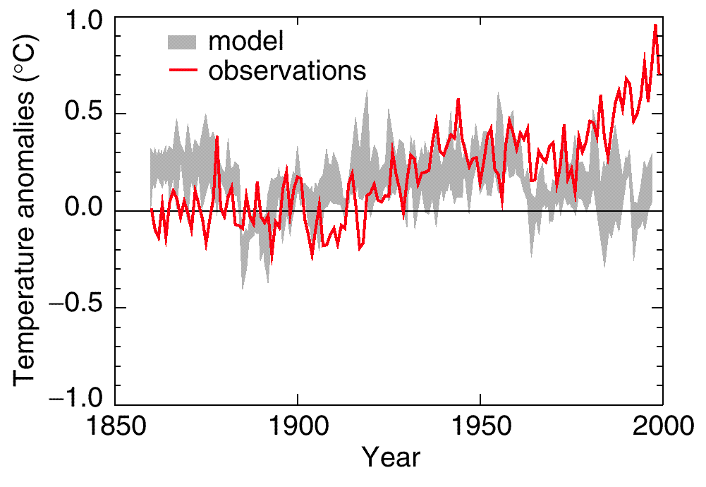
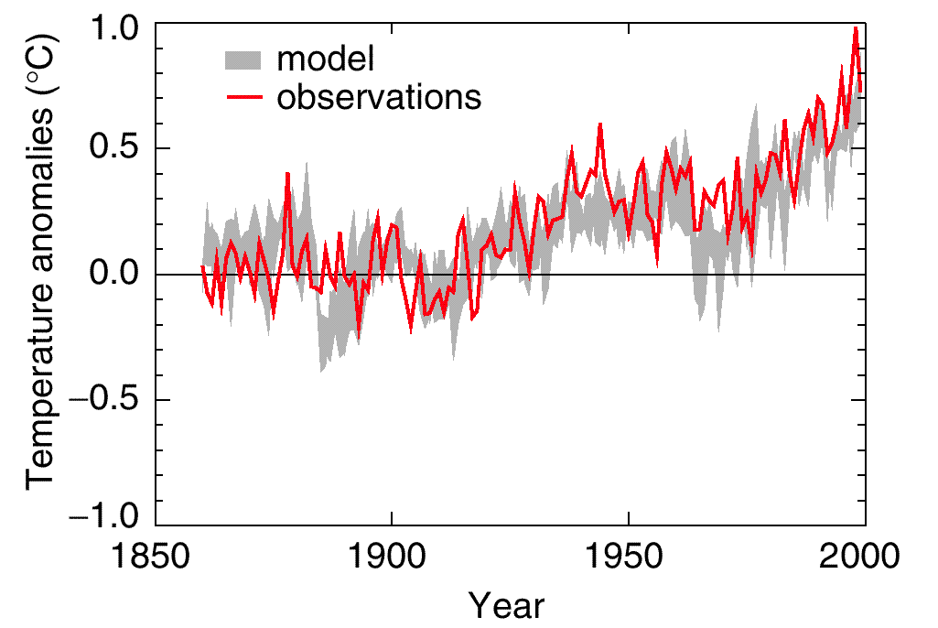
How Good are Climate Models?
Natural and Human Climate Influences
Natural Climate Influences
IPCC, modified
Observed changes in temperature since the
Industrial Revolution cannot be accurately represented
without including human influences.

Slide 25
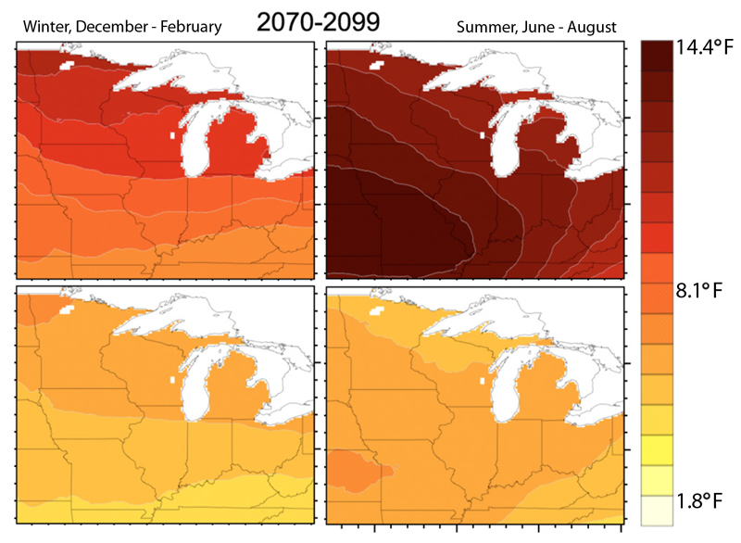
Future Midwest Temperature
High Emissions Scenario
Low Emissions Scenario
Modified from Hayhoe et al, 2010

Slide 26
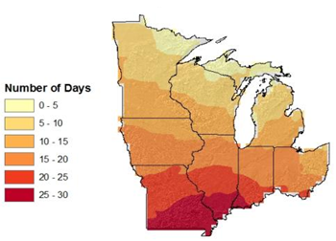
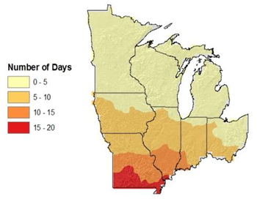
More Hot Days
2041-2070
Increase in Days
> 95°F
Increase in Consecutive Days
> 95°F
Kunkel (2011)

Slide 27
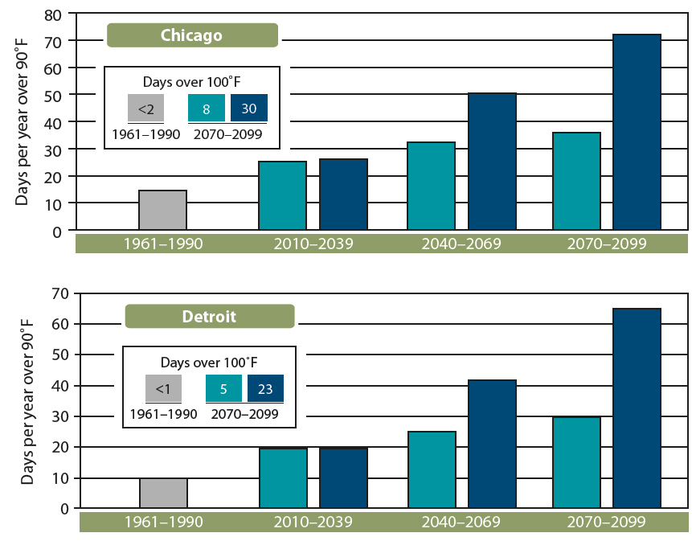
More Hot Days

Slide 28
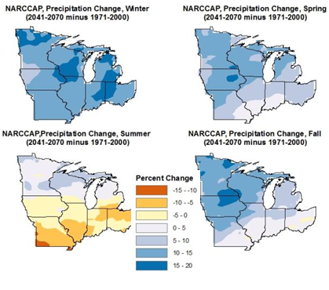
Projected Precipitation
2041-2070 vs. 1971-2000
Annual
+5 to 15%
Winter
+5 to 20%
Spring
+0 to 20%
Summer
+10 to -10%
Fall
+0 to 20%
Kunkel (2011)

Slide 29
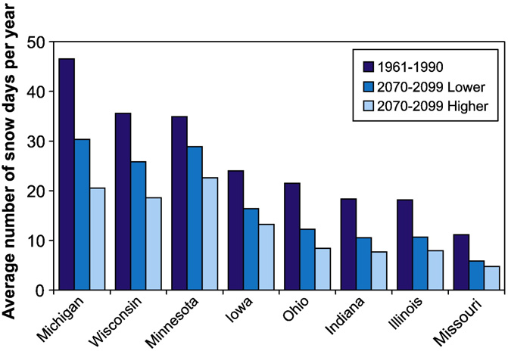
Projected Snowfall Days
Hayhoe et al (2010)

Slide 30

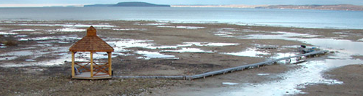
Summary of Projected Changes
Temperature
  Winter + 7 (5-10)°F
  Summer + 9 (5-12)°F
  Extreme heat more common
Precipitation
  Winter, Spring, Fall increasing
  Summer Decreasing – drier soils, more droughts
More extreme events – storms, floods
Ice cover decline will continue

Slide 31
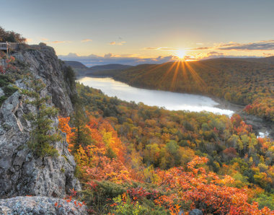
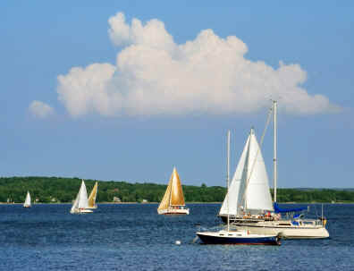
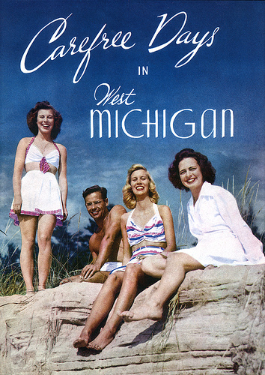
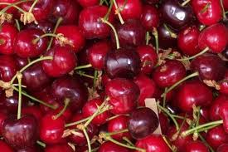
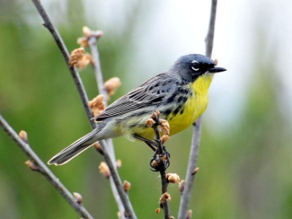
Impacts of Climate Change in the Great Lakes Region
Changes in temperature and precipitation throughout the region will lead to many impacts in both engineered and natural environments.
Fish
Water
Energy
Forests
Agriculture
Biodiversity
Public Health
Transportation
Birds and Wildlife
Tourism and Recreation

Slide 32
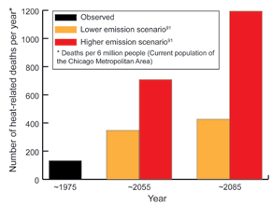
Projected Heat-Related Deaths in Chicago
High Emissions
Low Emissions
Observed
USGCRP (2009)

Slide 33
Example of Cascade Impacts
Changes in Climate
Temperature
Precipitation
Physical Effects
Increased Runoff of Pollutants, Changed Lake Physics
Impacts
Beach Closures, Algal Blooms, Dead Zones

Slide 34


Water Quality
Climate Change will increase the risk of many existing water quality and environmental issues.
NASA

Slide 35



Impacts of Climate Change on Forests
Amplification of existing stressors, such as invasive species, pests and pathogens
Many tree species will not be able to migrate quickly enough to keep pace with climate change
As the timing and extent of many recreation opportunities in forests will change, cultural connections to forests will be lost.

Slide 36

Projected Shifts in Forest Types
Maple-Beech-Birch
Oak-Hickory
USGCRP (2009)

Slide 37



Climate Change Impacts on Biodiversity
Climate change will amplify existing stressors on biodiversity, including sensitivity to land and water use.
Some species will need to migrate faster relative to other parts of the continent to keep up with the pace of warming. Large agricultural areas and the Great Lakes pose major obstacles to species migration.

Slide 38


Changing Fish Populations
Warmer lake temperatures
Warmwater species (carp, perch, bass)
gain advantage over existing
coldwater species (salmon, trout)
Implications for
recreational fishing and tourism

Slide 39


Bird Species Changes and Losses
Some species will gain an advantage while others are forced out of the region.
Even with new species in the region, Michigan will see a drop in the total number of bird species.
American Goldfinch
Will likely see populations decline
Summer Tanager
Will likely see populations grow
Hellmann et al (2010)
Notes:
Hellmann et al (2010)
Sousounis and Bisanz (2000)

Slide 40

Longer Projected Growing Season
Earlier last winter frost in spring
Later first winter frost in autumn
Growing season longer by
~1-2 months
Wubbles & Hayhoe (2004)
Notes:
Figure 3. Changes in length of frost-free season and dates of last spring and ﬁrst autumn frost over
the Midwest states. Historical data on the frost-free season is shown from 1900–2000, based on
daily minimum temperature records gridded from over 300 stations around the Midwest (Kunkel
et al. 1998). HadCM3 projections from 2001–2099, based on daily minimum temperature outputs
calibrated to historical growing season lengths over the reference period 1961–1990, are shown in
black for the higher A1FI scenario and gray for the lower B1 SRES emission scenario. Bars show
year-to-year variability while solid lines indicate 10-year running means.

Slide 41

Climate Change Impacts on Agriculture
Increasing intensity of severe storms
increases the risk of runoff and
erosion.
Shifts in the timing of precipitation
will affect field preparation time
in spring.
Some crops may benefit in the near future from increasing carbon dioxide concentrations until negated by warmer temperatures.
Perennial crops may be more vulnerable to the pace of climate change and may face greater adaptation challenges.

Slide 42

Agriculture Vulnerabilities Example: Spring 2012 and Cherry Crops
The early warming was
extreme weather event.
The seasonal warming fits
a pattern of a more
variable climate.
The early warming followed by a normal hard freeze was devastating to cherry buds.

Slide 43

A Vulnerability Example:
Early Spring Warming and Tart Cherries
2012
Date of Side Green vs. Year
1901-2012, Traverse City, MI

Slide 44


Climate Change Impacts on Energy
Extreme weather events would further burden the supply of electricity.
Overall, warmer temperatures may decrease the efficiency of electrical generation equipment in the Midwest.
Climate change policy will have an indelible impact on the energy sector.

Slide 45



Potential Transportation Impacts
Freeze-thaw
Expansion buckling
Freeze-thaw damage, near Marquette, MI
Expansion buckling near Marshall, MI, 2011
Flood Damage, washouts
Jane-Finch.com

Slide 46


How will we adapt?
Winter is a part of our
“Sense of Place”.
We are losing Winter as we once knew it.
-John Magnuson

