Slide 1
Bloom Time
Grape Disease Control
June 11, 2015
Brad Baughman
MSU Extension
Horticulture Educator
Berrien County

Slide 2
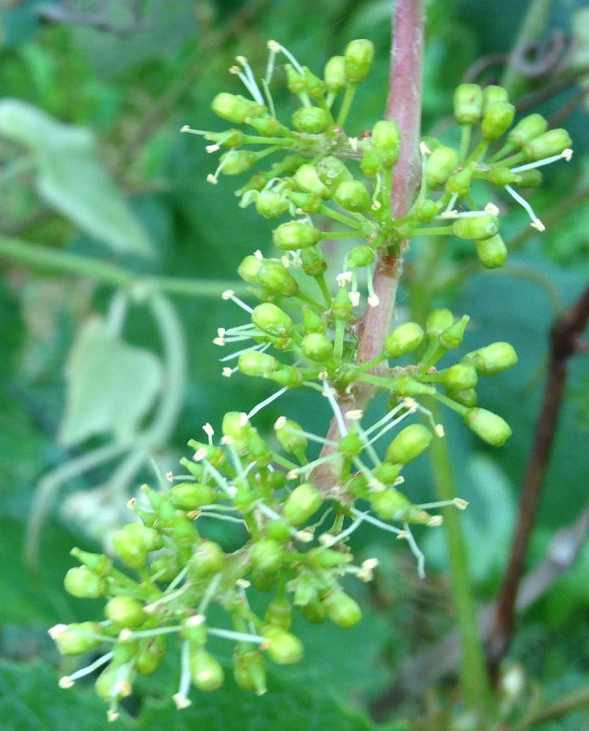
Bloom time
Niagara, Coloma/Wvlt area
Concord in south County

Slide 3
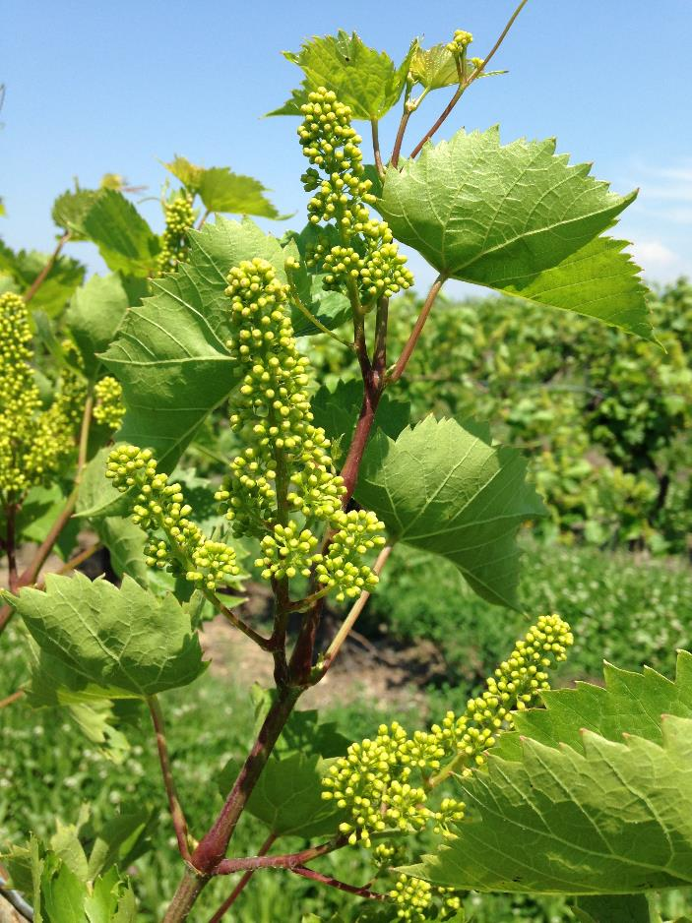
Bloom time
Wine grapes: caps still on
← Chambourcin

Slide 4
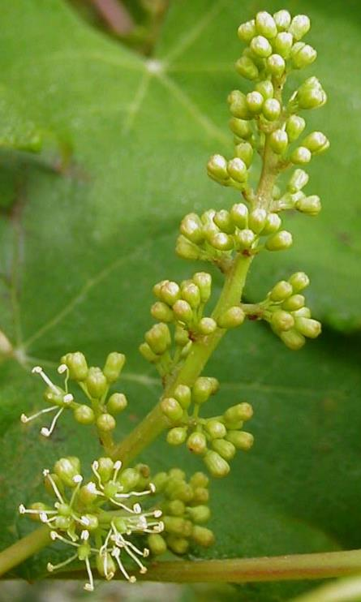
Bloom time
Most critical time for disease control: just before bloom until 2-4 weeks after bloom.
For all diseases except botrytis and sour rots.

Slide 5
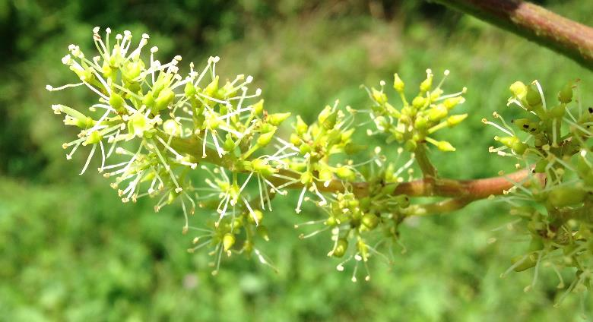
Cluster susceptibility
Downy Mildew
Powdery Mildew
Black Rot
(Botrytis)
pre-bloom,
during bloom,
and several weeks after bloom ends

Slide 6
Infection risk in Michigan
1-3” 5-8” 10-16” Immediate Buckshot Bunch Verai- Pre- Post
Disease Shoot Shoot Shoot Pre-bloom Berry Closure son Harvest Harvest
Leaf/
shoot
Phomop-
sis
Rachis
Berry
Black rot
Powdery mildew
Downy mildew
Arrow
4-5 weeks

Slide 7
Types of Fungicides
Protectants
  On surface of plant - kill fungal spores as they germinate, therefore:
    Preventative only
  Kill by poisoning several sites in fungus, therefore:
    Less likely for resistance to develop
Systemics
  Absorbed into plant and kill fungus as it penetrates the plant.
  Generally a single-mode poison:
    resistance more likely

Slide 8
Modes of Action
  Rotate FRAC codes throughout the season!
  Especially with systemic fungicides
FRAC code:
Fungicide Resistance Action Committee

Slide 9
Types of Fungicides
Protectants
  On surface of plant - kill fungal spores as they germinate, therefore:
    Preventative only
  Kill by poisoning several sites in fungus, therefore:
    Less likely for resistance to develop

Slide 10
Types of Fungicides
Protectants
  Sulfur and Lime Sulfur (M2)
    *Do not use on Concords*
    Other sensitive vars: Foch & Chambourcin
  Salts and Mineral oils (NC)
    Armicarb, Kaligreen
    JMS Stylet Oil
  Copper products (NC)
    many formulations – some for organic production

Slide 11
Types of Fungicides
Protectants
  Biological Protectants
    Serenade
    Sonata
    Double Nickel

Slide 12
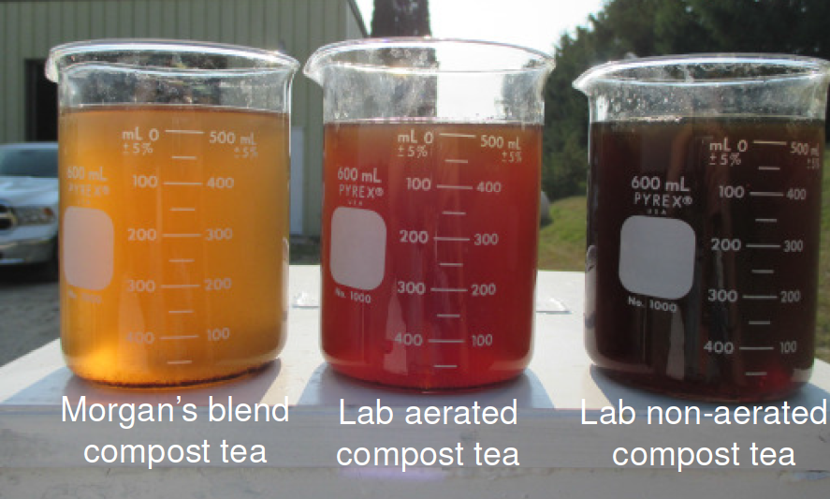
Types of Fungicides Materials
Protectant: Compost Tea
  Biological cover rather than chemical cover

Slide 13
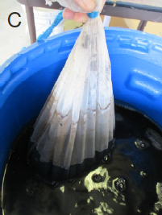
What is compost tea?
Mesh bag
Compost
e.g. fully composted
manure (MSU)
Water, aerated
or non-aerated

Slide 14
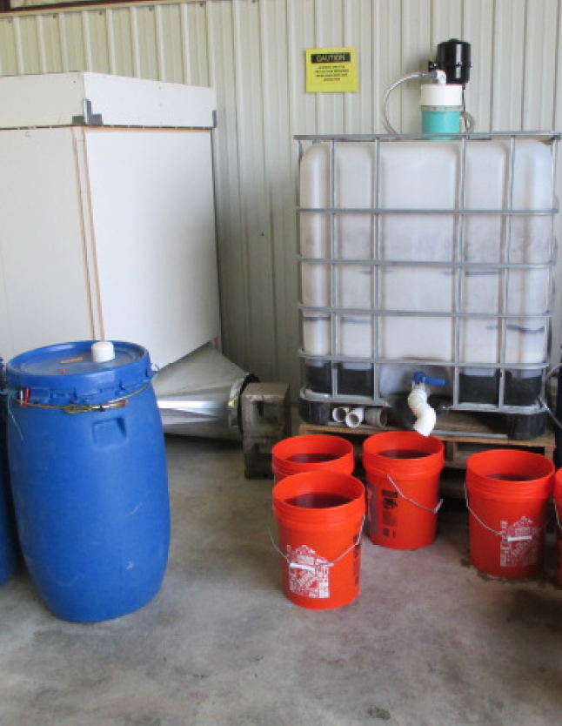
Compost Tea
Can be brewed in:
pales
barrels
totes
MSU: 2 week non-aerated
2 days aerated
Additives available,
e.g. “Morgan’s Blend”

Slide 15
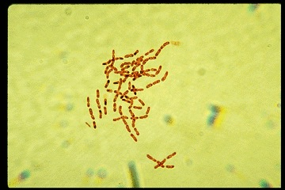
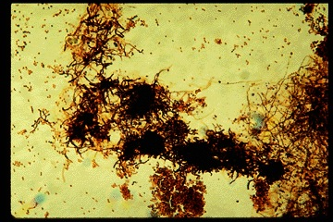
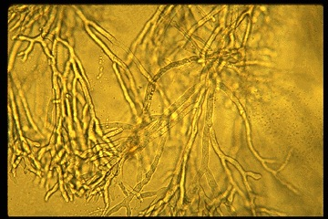
Compost Tea
How do they help?
  Biological rather than Chemical cover
Thousands of species of bacteria, fungi, yeasts, protozoans live in compost.

Slide 16
Compost Tea
Applied to plant surface, these microbes:
  Activate plant defenses
  Consume disease inoculum that lands on vegetation
  Secrete antibiotics

Slide 17
Compost Teas
Don’t believe everything you hear or read about compost teas
  A lot of mis-information available.
  Lots of ways to do it ineffectively
  Huge variation in efficacy depending on the contents of the compost – different organisms depending on the material…
  Becoming an active research area
MSU Plant Pathology, current research:
  “Dairy Doo” compost tea works as a protectant cover
  Greatest efficacy against powdery mildew,
    constant coverage necessary
    works best when rotated with other materials

Slide 18
Compost Teas
Necessities for efficacy and food safety:
  well-washed sprayer – no fungicide residues in tank
  no tank mixes
  thorough coverage necessary
  finished compost only

Slide 19
Types of Materials
Protectants
  On surface of plant - kill fungal spores as they germinate, therefore:
    Preventative only
  Kill by poisoning several sites in fungus, therefore:
    Less likely for resistance to develop
  Copper formulations (M1)
  Lime and Lime sulfur (M2)
  Salts and mineral oils (NC)
  Captan (M4)
  EBDCs, other Dithiocarbamates (M3)
  (Compost teas)
  Biological products

Slide 20
Types of Fungicides
Systemics
  Absorbed into plant and kill fungus as it penetrates the plant.
  Generally a single-mode poison:
    easier for resistance to develop
  Often have “Back Action”
    meaning you can treat an infection for a short period after it forms

Slide 21
Types of Fungicides
Systemics
  Strobilurins (11)
    Abound
    Flint
    Ranman
    Reason
    Sovran
    Tanos
  SIs (Sterol Inhibitors) (3)
    Bayleton
    Elevate
    Elite
    Mettle
    Rally

Slide 22
Types of Fungicides
Systemics
  Phosphonates (33)
    Agri-Fos, Prophyt, Phostrol, Rampart, Fosphite, Reveille
    Aliette = Legion = Linebacker
  Mefenoxam & Metalaxyl (4)
    Ridomil products, Metastar, Metalaxyl
  Carboxylic acid amides (40)
    Revus
    Forum

Slide 23
Types of Fungicides
Systemics
  Numerous other chemistries (7, 9, 43)
    Endura (7)
    Scala (9)
    Switch (9+12)
    Vangard (9)
    Presidio (43)

Slide 24
Types of Fungicides
Systemics
  Absorbed into plant and kill fungus as it penetrates the plant.
  Generally a single-mode poison:
    resistance more likely
  Strobilurins (11)
  SIs (Sterol Inhibitors) (3)
  Phosphonates (33)
  Ridomil (4)
  Carboxylic acid amides (40)
  Other… (2, 7, 9, 43)

Slide 25
Types of Fungicides
Systemics
  Strobilurins (11)
  SIs (Sterol Inhibitors) (3)
  Phosphonates (33)
  Ridomil (4)
  Carboxylic acid amides (40)
  Other… (2, 7, 9, 43)
Protectants
  Copper formulations (M1)
  Lime and Lime sulfur (M2)
  Salts and mineral oils (NC)
  Captan (M4)
  EBDCs, other Dithiocarbamates (M3)
  Biologicals
  Compost teas

Slide 26
Types of Fungicides
Pre-mixes
  Inspire Super (3 & 9)
  Revus Top (3 & 40)
  Luna Experience (3 & 7)
  Quadris Top (3 & 11)
  Pristine (7 & 11)
  Zampro (40 & 45)
  Ridomil Gold Copper (4 & M1)
  Ridomil Gold MZ (4 & M3)
3 – Sterol Inhibitors
11 - Strobilurins

Slide 27
DISEASE PRESSURE DURING BLOOM TIME
Fungicide materials lists in this presentation
are NOT exhaustive.
They are some of the commonly-used materials.
For info on specific products not listed,
check labels,
and look them up in MSU’s Fruit Management Guide

Slide 28
Powdery Mildew
Will be an issue if:
  lost control last year before mid-September
  no fungicide protection of early growth
  warm, wet, cloudy
  vulnerable varieties
Minimum spray for powdery:
  pre-bloom
  10-14 days later
Ongoing coverage of leaves if crop is heavy.
Concord and Niagara:
-3wk | -2wk | -1wk | Bloom | +1wk | +2wk | +3wk | +4wk | +5wk | +6wk
V. vinifera:
Fruit susceptible
-3wk | -2wk | -1wk | Bloom | +1wk | +2wk | +3wk | +4wk | +5wk | +6wk

Slide 29
Powdery Mildew
Product Name | Chemical class | Fruit infections of powdery
Rally | 3 - SI | +++
Elite | 3 - SI | +++
Abound | 11 - strob | ++
Sovran | 11 - strob | +++
Flint | 11 - strob | +++
Serenade* | (biological) | ++ | protectant only
Sonata* | (biological) | ++ | protectant only
Sulfur products* | M2 | ++ | protectant only
This is not an exhaustive list of effective materials!
These are just some of the common materials
* = OMRI-approved,
can be used in organic production

Slide 30
Powdery Mildew
Product Name | Chemical class | Fruit infections of powdery
Vivando | U8 | +++
Quintec | 13 | +++
Torino | U6 | +++
Luna Experience | 3 + 7 | +++
Pristine | 11 + 7 | +++
Merivon | 11 + 7 | +++
Inspire Super | 3 + 9 | +++
Revus Top | 3 + 40 | +++
Special products
for powdery mildew
Pre-mix products

Slide 31
Downy Mildew
Leaf infections usually visible shortly before bloom time
Rain splash required for infection
Ridomil & its generics are the big guns
Phosphonates also very strong v. DM
Captan, EDBCs, Strobs, Copper also effective
-3wk | -2wk | -1wk | Bloom | +1wk | +2wk | +3wk | +4wk | +5wk | +6wk
Fruit & rachis susceptible
Rachis susceptible

Slide 32
Downy Mildew
Product Name | Chemical class | Fruit infections of downy
Aliette | 33 - phos | +++
Prophyt | 33 - phos | +++
Phostrol | 33 - phos | +++
Ziram | M3 - EBDC | ++ | protectant only
Dithane / Manzate | M3 - EBDC | +++ | protectant only
Captan | M4 - captan | +++ | protectant only
Abound | 11 - strob | ++
Sovran | 11 - strob | +++
Flint | 11 - strob | +++
Serenade * | (biological) | ++ | protectant only
Copper products * | M2 | +++ | protectant only

Slide 33
Downy Mildew
Product Name | Chemical class | Fruit infections of downy
Ridomil Gold Copper | 4 + M1 | +++
Ridomil Gold MZ | 4 + M3 | +++
Pristine | 11 + 7 | +++
Merivon | 11 + 7 | +++
Revus | 40 | ++
Revus Top | 3 + 40 | +++
Pre-mix products

Slide 34
Black Rot
Usually good control achieved w/ spray at capfall, +2wks, +4wks
Only 2 sprays if early growth protection was flawless
More than 3 if it wasn’t great
Strobs (11) best for protection,
SI’s (3) best for back action!
Concord and Niagara:
-3wk | -2wk | -1wk | Bloom | +1wk | +2wk | +3wk | +4wk | +5wk | +6wk
V. vinifera:
Fruit susceptible
Somewhat susceptible
-3wk | -2wk | -1wk | Bloom | +1wk | +2wk | +3wk | +4wk | +5wk | +6wk

Slide 35
Black Rot
Product Name | Chemical class | Fruit infections of black rot
Rally | 3 - SI | +++
Elite | 3 - SI | +++
Manzate | M3 - EBDCs | +++ | protectant only
Ziram | M3 - EBDCs | ++ | protectant only
Ferbam | M3 - EBDCs | ++ | protectant only
Captan | M4 | +++ | protectant only
Abound | 11 - strob | +++
Sovran | 11 - strob | +++
Flint | 11 - strob | +++
Prophyt | 33 - phos | ++
Phostrol | 33 - phos | ++

Slide 36
Black Rot
Product Name | Chemical class | Fruit infections of phomopsis
Serenade* | (biological) | + | protectant only
Copper* | M1 | + | protectant only
Quadris Top | 3 + 11 | +++
Luna Experience | 3 + 7 | +++
Pristine | 11 + 7 | +++
Merivon | 11 + 7 | +++
Inspire Super | 3 + 9 | +++
*OMRI approved materials. Better than nothing, but neither are good for black rot;
no OMRI materials are good for black rot! Which is why…
cultural control is key for black rot management in organic grape production!

Slide 37
Phomopsis
Most inoculum discharged before bloom – early sprays are key for effective control.
But infections are ongoing, until mid-July or so
Only one generation per year – doesn’t proliferate fast like powdery or others
all tissues are somewhat vulnerable to phomopsis infection from the start!
-3wk | -2wk | -1wk | Bloom | +1wk | +2wk | +3wk | +4wk | +5wk | +6wk

Slide 38
Phomopsis
Product Name | Chemical class | Fruit infections of phomopsis
Rally | 3 | +
Elite | 3 | +
EBDCs | M3 | +++ | protectant only
Captan | M4 | +++ | protectant only
Abound | 11 | +++
Sovran | 11 | +++
Flint | 11 | +++
Agri-Fos | 33 | ++
Prophyt | 33 | ++
Phostrol | 33 | ++

Slide 39
Phomopsis
Product Name | Chemical class | Fruit infections of phomopsis
Serenade* | (biological) | ++ | protectant only
Sonata* | (biological) | ++ | protectant only
Sulfur products* | M2 | + | protectant only
Luna Experience | 3 + 7 | +++
Pristine | 11 + 7 | +++
Merivon | 11 + 7 | +++
Inspire Super | 3 + 9 | +++

Slide 40
Botrytis
Latent infections can form during bloom
Most of them will never become active or cause any problem!
But they develop if we have air moisture and soil moisture pre-harvest
mostly just in tight-clustered wine grapes
Different set of chemistries for Botrytis than other varieties
FRAC group 7, 9, 12
At least one Botrytis-active material during bloom will reduce rot development later in the year.

Slide 41
Botrytis
Product Name | Chemical class | Fruit infections of botrytis
Endura | 7 | ++ | (use high rate)
Luna Experience | 7 + 3 | +++
Pristine | 7 + 11 | ++
Merivon | 7 + 11 | ++
Inspire Super | 9 + 3 | ++
Scala | 9 | +++
Vangard | 9 | +++
Switch | 9 + 12 | +++
Elevate | 3 | ++

Slide 42
Questions? Comments? Corrections? Observations?
Feel free to contact me:
Brad Baughman
269-235-5440
baughm30@anr.msu.edu

Slide 43
Sources, and Further Reading
Michigan Fruit Management Guide 2015, Michigan State University Extension
“Grape Disease Control 2015”, Wayne F. Wilcox, Cornell University:
“2014 Production Guide for Organic Grapes” Cornell University

